Slide 1
CLCPA and NYS Economywide Cap-and-Invest Program
NYS DEC Update
Key Environmental Issues in U.S. EPA Region 2
Jon Binder, Deputy Commissioner for
Climate Change, Air Resources, and Energy
May 19, 2023, Columbia Law School

Slide 2
Overview
CLCPA Requirements and Main Sources of GHG Emissions in NYS
Community Air Monitoring Initiative
Economywide Cap-and-Invest Program

Slide 3
Climate Leadership and Community Protection Act (CLCPA) – Overview
Sets NYS on a path toward a carbon-neutral economy, mandating at least an 85% reduction in GHG emissions below 1990 levels by 2050
  Requires 40% reduction in emissions by 2030 (ECL § 75-0107)
Requires 100% emission-free electricity by 2040 (PSL § 66-p)
  70% renewable electricity by 2030
  9,000 MWs of offshore wind by 2035
  6,000 MWs of solar generation by 2025
  3,000 MWs of energy storage by 2030
Contains critical commitments to climate justice and a just transition

Slide 4
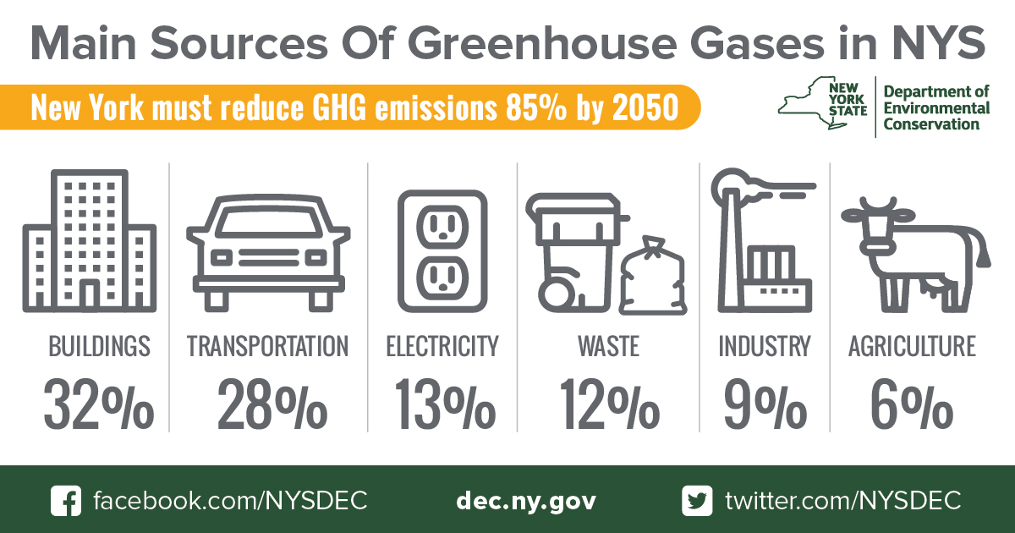
Notes:
People often think about electricity but we’ve actually made progress there through programs. Buildings and transportation where it’s at.
DEC will be issuing an updated inventory by the end of this year, but that will be for the year 2020, which is obviously a strange and unusual year.

Slide 5
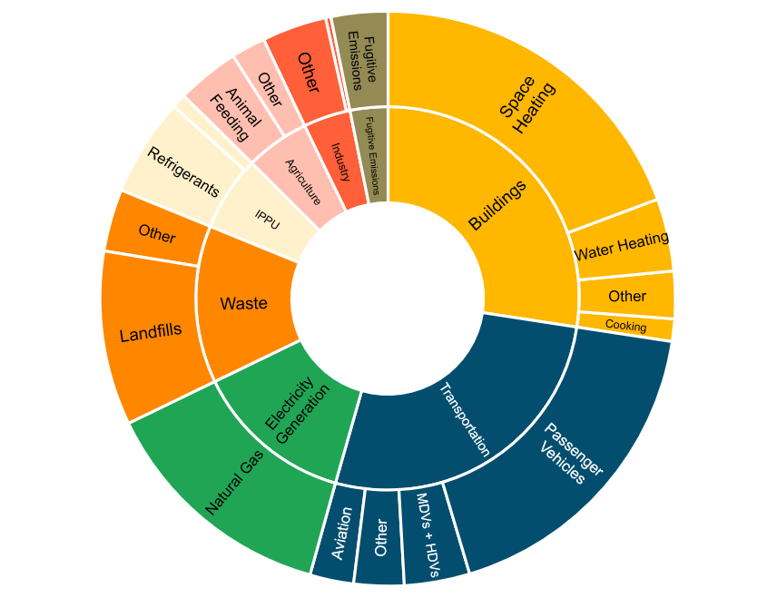
GHG Emissions Reduction Requirements
Current Estimated GHG Emissions by Sector
New York State GHG Emissions (MMtCO₂e)

Slide 6
Disadvantaged Communities and Community Air Monitoring
ECL § 75-0111 established the Climate Justice Working Group, which among other things established criteria and finalized maps to identify Disadvantaged Communities (next session today)
Utilized for many critical purposes under the CLCPA, including for permitting and other administrative decisions under Section 7(3)
Climate Act requires DEC to undertake community air monitoring in four DACs with potentially high exposure burdens
DEC expanded effort to monitor 10 communities Statewide
Community input and monitoring data will inform pollutant reduction strategies

Slide 7
Community Air Quality Monitoring
Identify air quality issues in DACs for future emissions reductions, for example:
    Long-term (e.g., diesel emissions reductions, regulations addressing stationary sources)
    Short-term (e.g., local facility inspection, permit enforcement)
Partner with and empower community organizations with easy-to-understand information on air pollution
Help to locate leaks in natural gas infrastructure
Identify sources of greenhouse gases and other pollutants
DEC holding quarterly community meetings to provide updates and data
Additional Info Available on DEC website 2022-23 Statewide Community Air Monitoring Initiative - NYS Dept. of Environmental Conservation

Slide 8
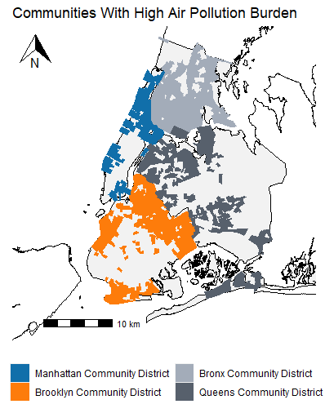
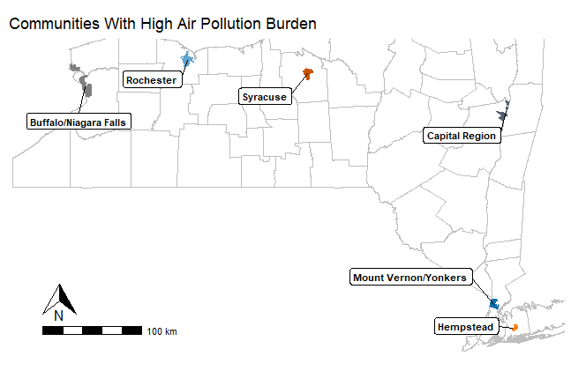
Communities Identified As
Higher Air Pollution Burden

Slide 9
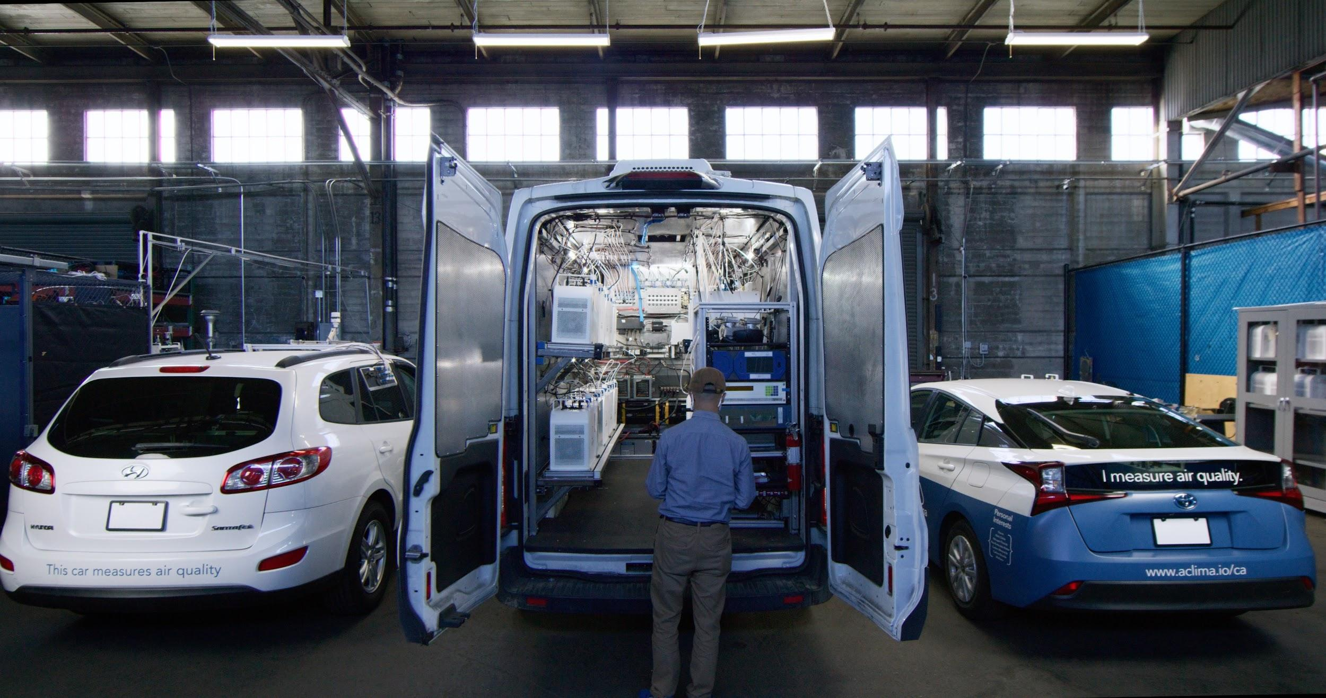
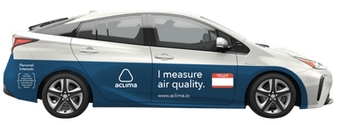
Mobile Air Quality Monitoring
Air pollution data collected by Aclima cars equipped with sensors driving along streets, block-by-block, across communities
Driving at least 20 times on each road segment at different times of day, days of the week, and seasons of the year

Slide 10
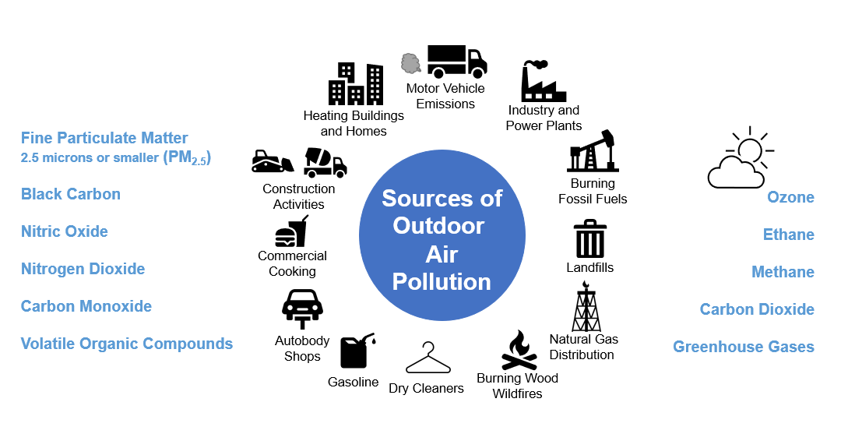
Targeted Pollutants & Sources
Sources of Outdoor Air Pollution

Slide 11
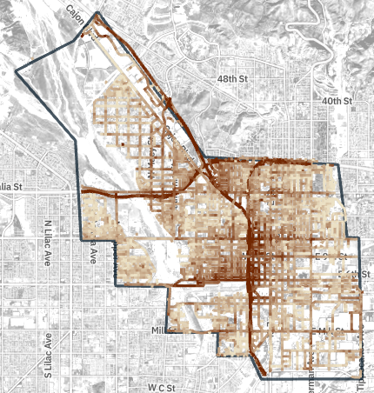
Aclima Mobile Sensors Platform
Results will be used to create pollutant gradient maps available to the public via an interactive website
Maps will include other data, such
as locations of sensitive receptors and community-led complementary monitoring efforts
San Bernardino, CA PM_{2.5}
Notes:
Other data are publicly available.

Slide 12
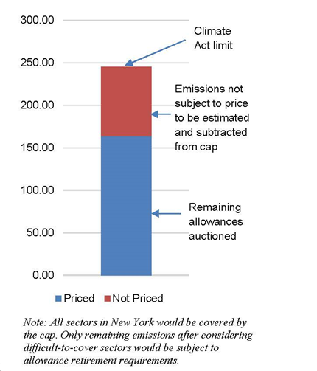
Economywide Cap-and-Invest Program
**Illustrative Only**
Advance an economywide Cap-and-Invest Program that establishes a declining cap on greenhouse gas emissions, limits potential costs to economically vulnerable New Yorkers, invests proceeds in programs that drive emission reductions in an equitable manner, and maintains the competitiveness of New York industries.
At Governor Hochul's direction, the program will incorporate these guiding principles:
  Affordability: Craft a program to deliver money back to New Yorkers to ensure energy affordability
  Climate Leadership: Catalyze other states to join New York, and allows linkage to other jurisdictions
  Creating Jobs and Preserving Competitiveness: Protect existing jobs and support new and existing industries
  Investing in Disadvantaged Communities: Ensure 35%+ of investments benefit DACs
  Funding a Sustainable Future: Support ambitious clean energy investment

Slide 13
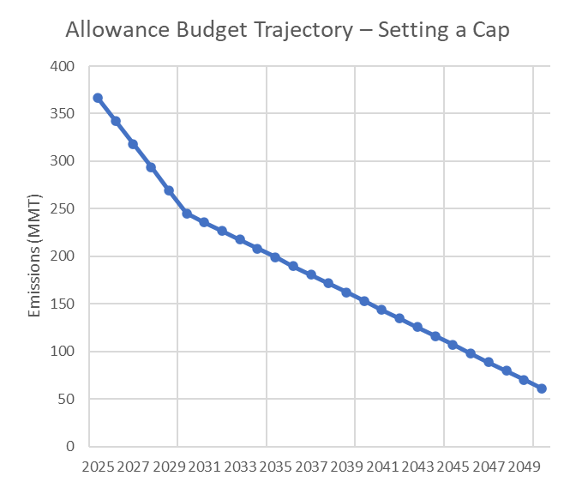
Cap-and-Invest: Achieving Emission Limits
  Over the coming year, DEC and NYSERDA will design a program that sets an annual cap on the amount of greenhouse gas pollution permitted to be emitted in New York.
  The declining cap ensures annual emissions are reduced, setting the state on a trajectory to meet our GHG emissions reduction requirements of 40% by 2030, and at least 85% from 1990 levels by 2050, as mandated by the Climate Act.
Illustrative Example

Slide 14
Cap-and-Invest: How it Works
Large-scale GHG emitters and distributors of heating and transportation fuels will be required to purchase allowances for the emissions associated with their activities.
The Cap-and-Invest Program will incentivize businesses, and other entities to transition to lower-carbon alternatives.
Proceeds will support:
    Critical investments in climate mitigation, energy efficiency, clean transportation, and other projects
    Consumer Climate Action Account that will deliver funds back to New Yorkers annually to ensure energy affordability

Slide 15
FY2024 State Budget and Cap-and-Invest
This year’s enacted State budget further advanced New York’s Economywide Cap-and-Invest by establishing the financial foundation required to support the Program
The recently enacted budget includes:
    Consumer Climate Action Account – 33% of future proceeds provided to New Yorkers to help address affordability.
    Climate Investment Account – 67% of future proceeds for emissions reduction and clean energy investments consistent with Scoping Plan.
    Climate Affordability Study due January 1, 2024 to provide recommendations for Consumer Climate Action Account
    Labor and prevailing wage provisions for projects funded through the Climate Investment Account.

Slide 16
Regulatory Framework
DEC and NYSERDA plan to develop three regulations to implement an economywide cap-and-invest program (NYCI)
  DEC Mandatory Greenhouse Gas Reporting Program (Part 253)
  DEC Economywide NYCI Program (Part 252)
  NYSERDA Auction Rule
  DEC is drafting and will promulgate enforceable regulations to ensure the State meets the Climate Leadership and Community Protection Act’s Statewide GHG emission limits (40x30 and 85x50) as outlined in the Scoping Plan

Slide 17
Cap-and-Invest Regulation Development Timeline
Current Stage
Initial Stage of Pre-Proposal Outreach
Assess Input and Further Develop Pre-Proposal
Second Stage of Pre-Proposal Outreach
Assess Input and Develop Proposal
Issue Regulatory Proposal
Formal Comment Period and Hearings
Assessment of Public Comments
Issue Final Regulations
Mandatory Reporting Begins
Compliance Begins

Slide 18
Cap-and-Invest Program: Emissions Reporting
Cap-and-invest programs require emissions reporting from emissions sources
Entities with reporting requirements will likely be more numerous than entities with allowance compliance obligations
  Supports integrity of emissions allowance determinations
  Supports integrated reporting platform for multiple programs
  Helps to identify future actions

Slide 19
Equity Consideration for Disadvantaged Communities
CLCPA directs that a minimum of 35% of proceeds -- with a goal of 40%-- be invested to benefit Disadvantaged Communities.
In addition to investments to reduce emissions, DEC is soliciting feedback about any additional regulatory mechanisms in the Cap-and-Invest regulation that should be considered to ensure emission reductions in DACs.

Slide 20
Distinguishing Elements in NYCI Program Development
All GHG emissions would be accounted for under the Program and the cap must reduce at a rate to achieve the Statewide GHG emission limits.
DEC is considering the concept of obligated and non-obligated sources.
    Obligated sources identified by regulation and required to provide allowances equal to GHG emissions.
    Non-obligated sources contribute to GHG emissions and must be accounted for in the overall cap, but allowances to cover GHG emissions from non-obligated sources will be retired by DEC.

Slide 21
Overview of Cap-and-Invest Program Elements
Applicability and thresholds
Allowance allocation and auction
Cap and allowance budget
Program stability mechanisms
Compliance, enforcement, and penalties
Reporting and verification

Slide 22
Next Steps in Regulatory Process
DEC and NYSERDA are engaging with a variety of stakeholders regarding these and other details of the Program
DEC and NYSERDA will soon begin a series of pre-proposal webinars as we seek additional input in advance of a formal draft regulatory proposal
The series will include an opportunity to learn about the process and to provide input in response to a series of questions under consideration
Additional information will be available on climate.ny.gov

Slide 23

Thank You!
Jon Binder, Deputy Commissioner
Climate Change, Air Resources, and Energy
Jonathan.Binder@dec.ny.gov

